Slide 1
Introduction to Web Services
Working with JAX-RS
Notes:
Add instructor notes here.

Slide 2
Lesson Objectives
Working with JAX - RS
JAX – RS Annotations
Creating JAX – RS web service
Consuming RESTful service
Notes:
Following contents would be covered:
3.1: What is REST
3.1.1 : SOAP and REST
3.2: Working with JAX - RS
3.3: JAX-RS annotations
3.4: Creating JAX – RS web service
3.5: Consuming RESTful service
Slide discuss summary of the points to be covered

Slide 3
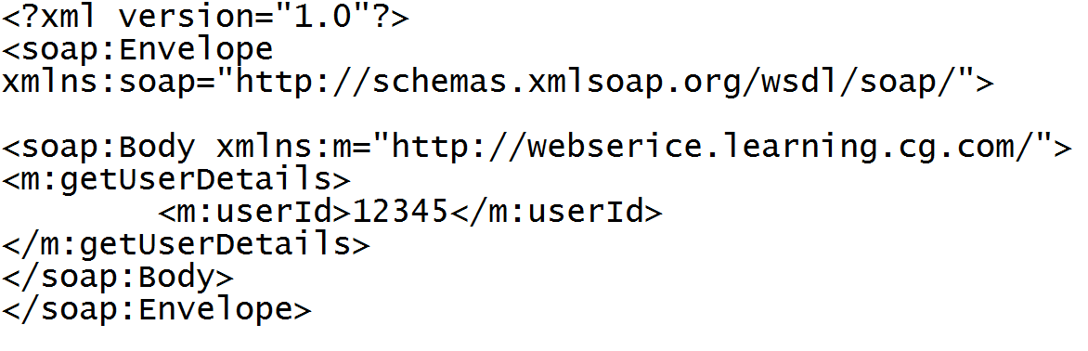
3.1.1: SOAP and REST SOAP and REST
Consider a scenario where a web service is going to query a phonebook application for the details of a given user when the user's ID is known
A SOAP message request looks like:
Consider a scenario where a web service is going to query a phonebook application for the details of a given user when the user's ID is known
A REST request URI looks like:
http://localhost/phonebook/UserDetails/12345
Notes:
As seen in above slide same scenario is represented in both forms SOAP and REST
REST turns out to be an easier implementation.
REST vs. SOAP is like mailing a letter:
with SOAP, you're using an envelope;
with REST, it's a postcard. Postcards are easier to handle (by the receiver), waste less paper (i.e., consume less bandwidth), and have a short content.
With REST, the semantics are specified entirely by the URI
With REST, the URI is the end
REST: oriented around nouns – Resources
Following examples can be considered:
http://example.com/customer/123
http://example.com/order/555/customer
{POST, GET, DELETE}
REST services are built around Resources
REST services are Stateless and use a Uniform Interface. Resources are manipulated through Representations. Messages are Self-Describing
Differences between SOAP and REST
SOAP REST
1. Is Simple Object Access Protocol 1. REST is Representational State Transfer
2. SOAP requires more bandwidth 2. REST requires less bandwidth
3. SOAP permits only XML 3. REST permits different data formats like text, XML, JSON (Java script Object Notation) data formats
4. SOAP is Transport layer 4. REST requires use of HTTP
independent (HTTP).
It can be used over SMTP
as well.
5. SOAP is a standard to interact 5. REST has small learning curve and uses URI to Interact with Web services
with Web service
Slide shows the differentiation between a soap request and REST URI

Slide 4
3.2: JAX - RS Working with JAX - RS
JAX-RS is a Java programming language API designed to make it easy to develop applications that use the REST architecture
Moreover annotations are used to simplify the development of RESTful web services
JAX-RS annotations define resources and the actions that can be performed on those resources
Creating a RESTful Root Resource Class
Root Resource classes are POJOs that are annotated with @Path or have at least one method annotated with @Path
Resource methods are methods of a resource class annotated with a request method designator such as @GET, @PUT, @POST, and @DELETE
Notes:
There are many implementations of JAX – RS
Apache CFX, an Open source Web service framework
Jersey , the reference implementation from Oracle. We would be using Jersey implementation for our REST web services
Jersey is used because it makes development of RESTful web services easier.
RESTful web services created under Jersey can be deployed to any application server.
Moreover JAX – RS is a part of Java EE and can be used with other Java EE technologies.
Trainer can illustrate regarding JAX - RS.

Slide 5
3.3: JAX – RS Annotations JAX – RS Annotations
These are the few annotations that can be used with REST
@Path
The @Path annotation's value is a relative URI path indicating where the Java class will be hosted, for example, /helloworld.
@GET
The Java method annotated with this request method designator will process HTTP GET requests.
@POST
The Java method annotated with this request method designator will process HTTP POST requests.
@PUT
The Java method annotated with this request method designator will process HTTP PUT requests.
Notes:
The @Path annotation’s value is a relative URI path indicating where the Java class will be hosted: for example, /helloworld. You can also embed variables in the URIs to make a URI path template. For example, you could ask for the name of a user and pass it to the application as a variable in the URI: /helloworld/{username}.
The @GET annotation is a request method designator and corresponds to the similarly named HTTP method. The Java method annotated with this request method designator will process HTTP GET requests. The behavior of a resource is determined by the HTTP method to which the resource is responding.
URI for GET request in JAX-RS-CRUD Demo shared (http://localhost:9090/JAX-RS-CRUD/rest/countries)
The @POST annotation is a request method designator and corresponds to the similarly named HTTP method. The Java method annotated with this request method designator will process HTTP POST requests. The behavior of a resource is determined by the HTTP method to which the resource is responding.
URI for POST request in JAX-RS-CRUD Demo shared (http://localhost:9090/JAX-RS-CRUD/post.jsp) (Here the user enters the details to create a country. The values of which are passed to the controller via @FormParam-discussed in next slide)
The @PUT annotation is a request method designator and corresponds to the similarly named HTTP method. The Java method annotated with this request method designator will process HTTP PUT requests. The behavior of a resource is determined by the HTTP method to which the resource is responding.
Slide demonstrates a few JAX – RS annotations
Refer demo : JAX-RS-CRUD and notes page for the URI generated

Slide 6
3.3: JAX – RS Annotations JAX – RS Annotations
@DELETE
The Java method annotated with this request method designator will process HTTP DELETE requests
@FormParam
To bind HTML form parameters value to a Java method
@Consumes
The @Consumes annotation is used to specify the MIME media types of representations a resource can consume that were sent by the client
@Produces
The @Produces annotation is used to specify the MIME media types of representations a resource can produce and send back to the client: for example, "text/plain“ or application/json or application / xml
@PathParam
The @PathParam annotation is a type of parameter that you can extract for use in your resource class
Notes:
The @DELETE annotation is a request method designator and corresponds to the similarly named HTTP method. The Java method annotated with this request method designator will process HTTP DELETE requests. The behavior of a resource is determined by the HTTP method to which the resource is responding
URI for DELETE request in JAX-RS-CRUD Demo shared (http://localhost:9090/JAX-RS-CRUD/rest/countries/delete)
@FormParam: Used to bind HTML form parameters value to a Java method
With respect to the JAX-RS-CRUD demo shared - the values entered in post.jsp mentioned in previous slide are passed to controller method. Since we are using HTTP POST method the URI is not appended with parameters.
Following is the URI (http://localhost:9090/JAX-RS-CRUD/rest/countries) to demonstrate that new country is added.
The @Consumes annotation is used to specify the MIME media types of representations a resource can consume that were sent by the client.
@Consumes(MediaType.APPLICATION_JSON) specifies that the controller method will need an input parameter of type object of type JSON
The @Produces annotation is used to specify the MIME media types of representations a resource can produce and send back to the client: for example, "text/plain"..
In JAX-RS-CRUD demo shared - @Produces(MediaType.APPLICATION_JSON) specifies that the controller method will return an object of type JSON
The @PathParam annotation is a type of parameter that you can extract for use in your resource class. URI path parameters are extracted from the request URI, and the parameter names correspond to the URI path template variable names specified in the @Path class-level annotation
URI for GET request with Path parameter in JAX-RS-CRUD Demo shared (http://localhost:9090/JAX-RS-CRUD/rest/countries/3) (3 is the path parameter appended to the URI). Thus details with respect to country Id = 3 is fetched and displayed in browser.
Slide demonstrates a few JAX – RS annotations

Slide 7
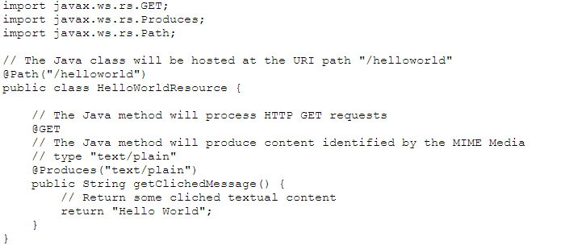
3.4: Creating a JAX - RS service Creating JAX – RS Service
Following code sample illustrates a simple example of a root resource class that uses JAX – RS annotations
Notes:
The @Path annotation’s value is a relative URI path. In the preceding example, the Java class will be hosted at the URI path /helloworld. This is an extremely simple use of the @Path annotation, with a static URI path.
Variables can be embedded in the URIs. URI path templates are URIs with variables embedded within the URI syntax.
The @GET annotation is a request method designator, along with @POST, @PUT, @DELETE, and @HEAD, defined by JAX-RS and corresponding to the similarly named HTTP methods. In the example, the annotated Java method will process HTTP GET requests.
The behavior of a resource is determined by the HTTP method to which the resource is responding.
The @Produces annotation is used to specify the MIME media types a resource can produce and send back to the client. In this example, the Java method will produce representations identified by the MIME media type "text/plain".
The @Consumes annotation is used to specify the MIME media types a resource can consume that were sent by the client.
The example could be modified to set the message returned by the getClichedMessage method, as shown in this code example:
@POST
@Consumes("text/plain")
public void postClichedMessage(String message)
{
// Store the message
}
Slide will demonstrate how to create a resource class

Slide 8
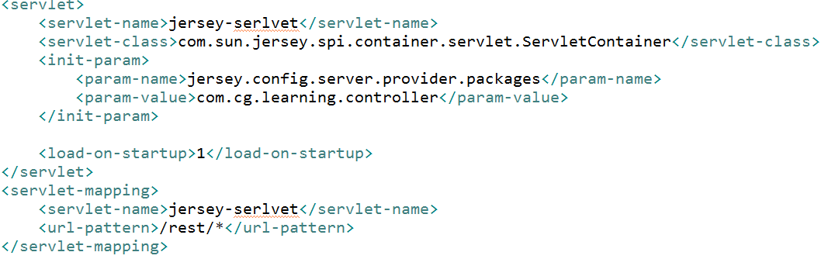
3.4: Creating a JAX - RS service Creating JAX – RS Service
Following mapping is needed in web.xml :
Notes:
From the above mapping all URL patterns will map through URLs with rest being a part of the URI.
An inbuilt servlet -> com.sun.jersey.spi.container.servlet.ServletContainer is a servlet (Filter) for deploying root resource classes.
Provides support for servlet-based and filter-based Web applications.
The above mapping will deploy Jersey and automatically register any root resource or provider classes present in the directory "/WEB-INF/classes" or jar files present in the directory "/WEB-INF/lib“
The init-param -> jersey.config.server.provider.packages defines one or more packages that contain application-specific resources and providers.
If the property is set, the specified packages will be scanned for JAX-RS root resources and providers.
Slide illustrates regarding jersey related ServletContainer mapping in web.xml

Slide 9
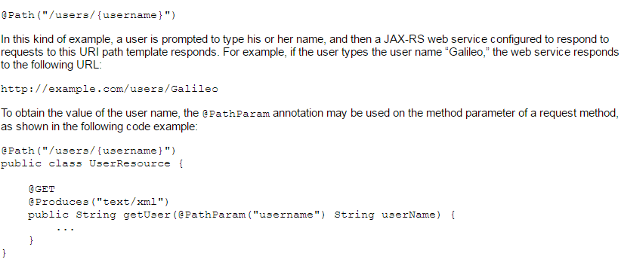
3.4: Creating a JAX - RS service Creating JAX – RS Service
More on @Path annotation and URI Path Templates
Look at below @Path annotation:
Notes:
The @Path annotation identifies the URI path template to which the resource responds and is specified at the class or method level of a resource.
The @Path annotation’s value is a partial URI path template relative to the base URI of the server on which the resource is deployed, the context root of the application, and the URL pattern to which the JAX-RS runtime responds.
URI path templates are URIs with variables embedded within the URI syntax. These variables are substituted at runtime in order for a resource to respond to a request based on the substituted URI. Variables are denoted by braces ({ and }). For example, look at the following @Path annotation:
@Path("/users/{username}")
Slide illustrates regarding @Path annotation and how to extract Path parameters

Slide 10
3.4: Creating a JAX - RS service Creating JAX – RS Service
URI Path Template | URI After Substitution
http://example.com/{name1}/{name2}/ | http://example.com/james/gatz/
http://example.com/{question}/{question}/{question} | http://example.com/why/why/why/
http://example.com/maps/{location} | http://example.com/maps/MainStreet
http://example.com/{name3}/home/ | http://example.com/james/home/
Notes:
Slide illustrates how an actual URI will be substituted.

Slide 11
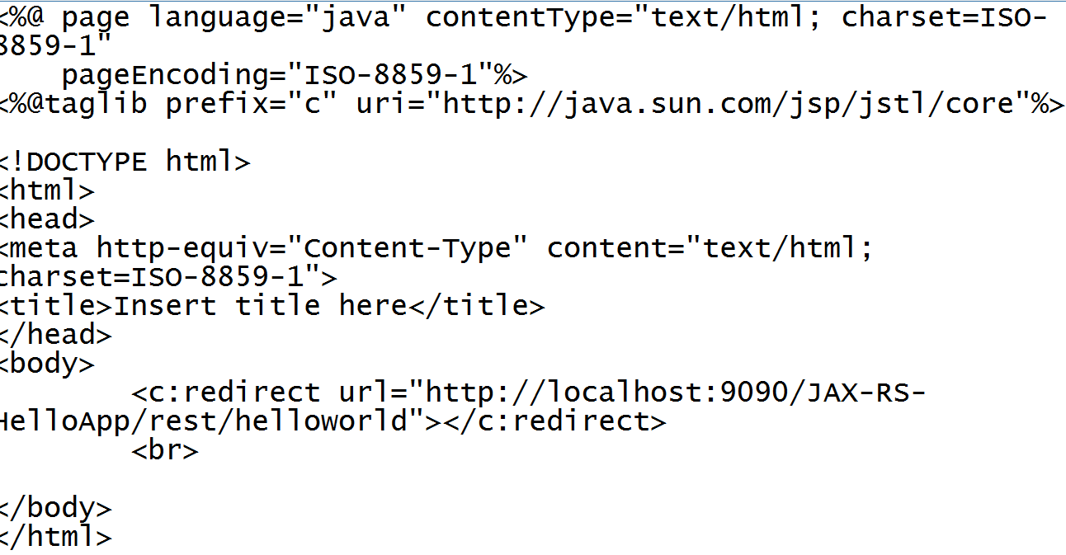
3.5: Consuming a JAX - RS service Consuming JAX – RS Service
Here we would need a web client to consume a resource
An jsp page can be created that can navigate to the specific URI.
The dynamic web project is created by name JAX-RS-HelloApp and URI’s are mapped through /rest/*
Notes:
When above jsp is executed, REST Service will look for Root resource class with @Path mapping as “/helloworld” and on finding the mapping will execute that corresponding method and return result in MIME type specified.
(Refer slide number 8)
Trainer can specify that a web client (jsp / html) will be used as a web service consumer in the same project.
Also a different project could be created for a web service consumer

Slide 12
3.5: Consuming a JAX - RS service Consuming JAX – RS Service
JAX-RS-CRUD
Notes:
Add the notes here.
Demo example on Restful service

Slide 13
Summary
So far we have learnt:
What is REST architecture
How REST is any easy alternative to create a web service
REST annotations
Creating a RESTful service
Consuming a RESTful service
Notes:
Add the notes here.
Summary of the topics being covered

Slide 14
Working with JAX-WS Lab
Lab 2
Notes:
Add the notes here.
Corresponding lab assignment

Slide 15
Review Question
Question 1: Which of the following are true?
Option1 : Resource classes are POJOs that have at least one method annotated with @Path
Option 2: Resource methods are methods of a resource class annotated with a request method designator such as @GET, @PUT, @POST, or @DELETE
Option 3: @FormParam binds query parameters value to a Java method
Question 2: The @Path annotation’s value is a relative URI path indicating where the Java class will be hosted?
True
False
Notes:
Add the notes here.
Question 1: Option 1, Option 2
Question 2: True

Slide 16
Review Question
Question 3: ___________ specifies a media type a resource can generate.
@PUT
@POST
@Produces
@Consumes
Notes:
Add the notes here.
Question 3: @Produces

